Slide 1
https://qdata.github.io/deep2Read/
Interpretation of Neural Networks is Fragile
Amirata Ghorbani, Abubakar Abid, James Zou
2018
Presented by Eli Lifland, 10/18/2019

Slide 2
Interpretation of Neural Networks
Explanations for why an algorithm makes a decision
Needed for trust between user and algorithm
Motivating examples:
Doctors understanding diagnoses
Lender and borrower understanding credit risk
Notes:
The motivation of this project

Slide 3
Interpretation Methods:
Feature Importance
Explains predictions in terms of importance of features
Simple gradient method: detects sensitivity of score to perturbing each dimension
Integrated gradients: gradients calculated with respect to several scaled versions of input
DeepLIFT: Decomposes score backwards through network, layer-wise propagation (LRP) method
Notes:
The motivation of this project

Slide 4
Interpretation Methods:
Sample Importance
Explains predictions in terms of importance of training examples
Influence equation used to calculate influence of each example, derived by Koh and Liang (2017)
Notes:
The motivation of this project

Slide 5
Importance of Robustness
Interpretations not robust to indistinguishable perturbations may be security concern
Doctor selecting wrong intervention, e.g. location of biopsy
Incorrect causal conclusions
Notes:
The motivation of this project

Slide 6
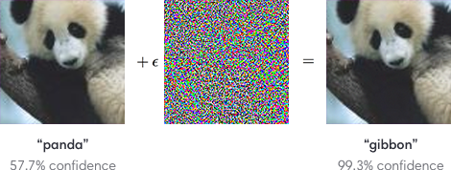
Adversarial Perturbations for Prediction
Notes:
The motivation of this project

Slide 7
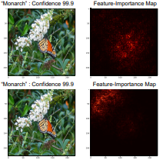
Adversarial Perturbations for Interpretation
Notes:
The motivation of this project

Slide 8
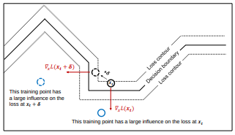
Intuition for Fragility of Interpretation
Notes:
The motivation of this project

Slide 9

Problem Statement
Notes:
The motivation of this project

Slide 10
Attacking Feature Importance Methods
Series of steps in direction which maximizes differentiable dissimilarity function between original, perturbed interpretation
Top-k attack: Decreases relative importance of k most important features
Mass-center attack for image data: maximizes spatial displacement of center of mass of feature importance map
Targeted attack for image data: Increases concentration of feature importance scores in pre-defined region of image
Notes:
The motivation of this project

Slide 11

Attacking Influence Function
Optimal single-step perturbation to decrease influence of 3 most influential training examples
Notes:
The motivation of this project

Slide 12
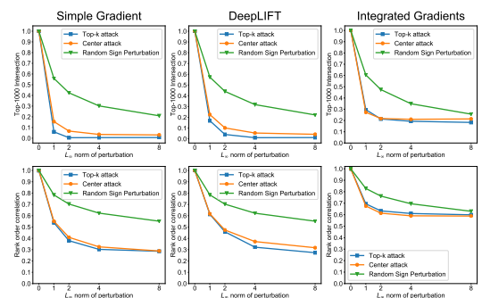
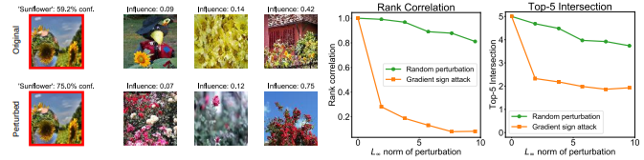
Results
Notes:
The motivation of this project

Slide 13
Hessian Analysis
Approximation of sensitivity of gradient-based interpretations to perturbation 𝛅 is:
∇_{x}S(x+𝛅) - ∇_{x}S(x) ≅ H𝛅, where H is the Hessian
Consider a linear model w^{T}x: ∇_{x}S(x) = w ∀ x. Thus the feature importance vector is robust
Consider the same model followed by a non-linearity (e.g. softmax) g(w^{T}x). The change in feature importance map is now Hᐧ 𝛅 = ∇²_{x}Sᐧ 𝛅. ∇²_{x}S is no longer 0. Authors show that change in feature importance map grow with dimension of w.
Thus, non-linearity and high dimensionality are causes of lack of robustness of interpretations
Notes:
The motivation of this project

Slide 14
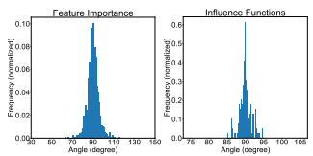
Orthogonality of Fragile Directions
Notes:
The motivation of this project

Slide 15
Conclusion
Robustness of interpretation of a prediction is important and challenging
Importance scores can be susceptible even just to random perturbations, but doubly so to targeted ones
Potential defense techniques:
Discretizing inputs
Constraining non-linearity of networks

